Slide 1



Online Game Level Generation from Music
Ziqi Wang
12132362@mail.sustech.edu.cn
Jialin Liu
liujl@sustech.edu.cn
Department of Computer Science and Engineering
Southern University of Science and Technology (SUSTech), Shenzhen, China

Slide 2
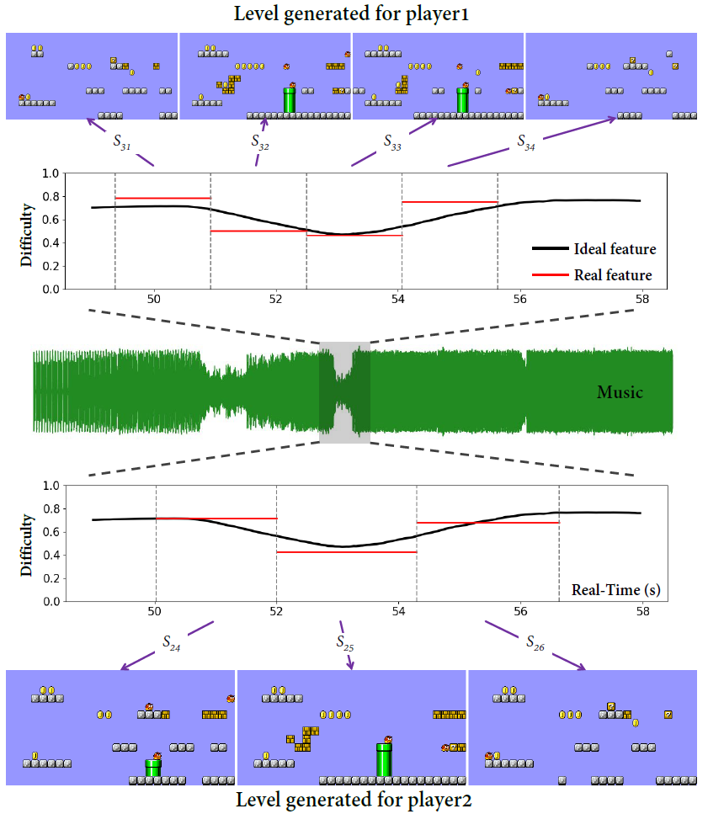
Motivation
Game consists of multiple types of content that affect player’s experience jointly.
We want the different contents be harmonic so that coherent experience is guaranteed.
In this work we specifically consider matching game level’s difficulty with the tension of background music over time.

Slide 3
Level Generation from Music Should be Achieved Online
How can a PCG system generate levels that match the gameplay experience with the background music?
We can map some music feature to the level feature
Challenge:
The desired level feature sequence can be translated from music features in advance, but:
We need to do calibration continually during the player playing level
We need to adapt specific player’s gameplay pace
The time point of music you want the level segment match
Music features
The actual time point when player playing this level segment
Level segment
Online (real-time) generation approach is necessary!

Slide 4
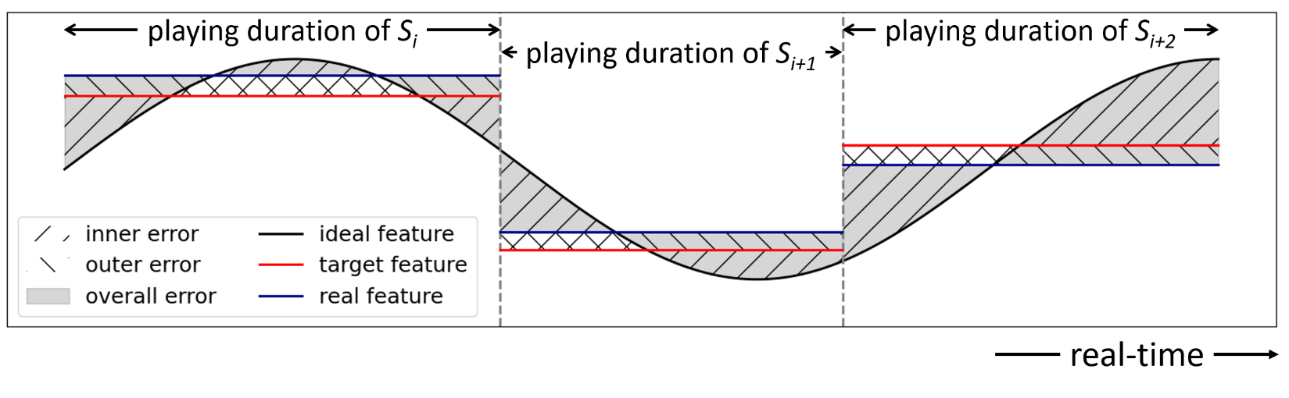
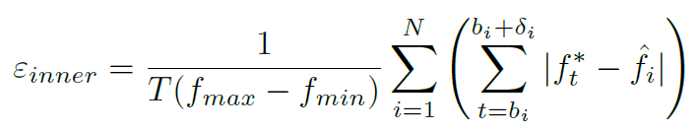
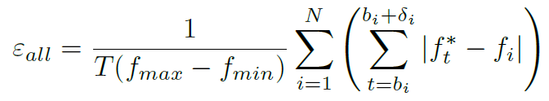
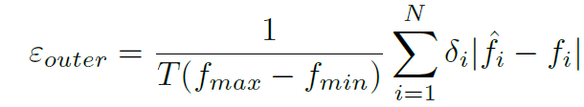
Problem Formulation
Final objective: minimize ε_{all}.
Approach: minimize ε_{inner} and ε_{outer}.
Challenge: the duration of playing each segment is not fixed and uncertain.

Slide 5
General Idea of Music-Driven Online Generation System
Player
Play data (duration of playing the last level segment)
New level segment
Controller
Generation System
Ideal feature sequence
desired feature of the next level segment
(Controllable)
Generator
(controller suggests it by predicting the time window that the current player will experience the next level segment)
Historical play data
In this work, the ideal feature sequence is the desired difficulty of the level at each time point, which is mapped from music’s “energy” feature at a high frequency.

Slide 6
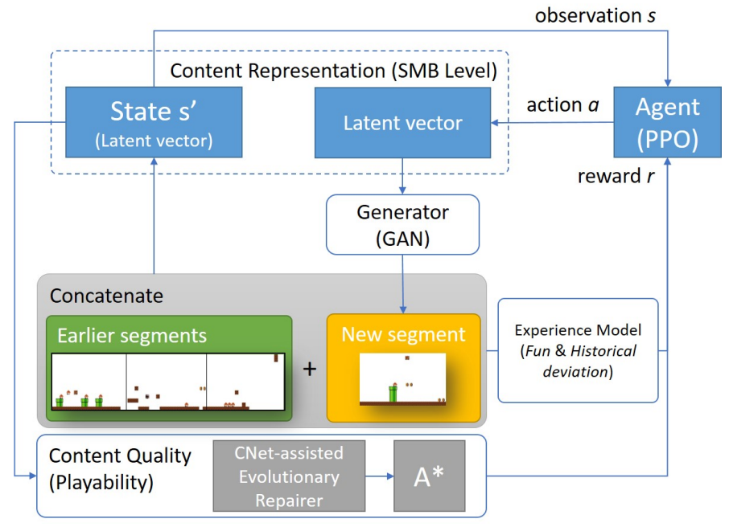
An Existing Online Generation Framework - EDRL
To minimise the requirements of expert knowledge, we build our system upon the EDRL framework.
We retain the experience model and content quality (as rewards of RL agent) in the original framework, to optimise the gameplay experience.
Figure borrowed from [1]
[1] Tianye Shu, Jialin Liu, and Georgios N. Yannakakis. "Experience-driven PCG via reinforcement learning: A Super Mario Bros study." 2021 IEEE Conference on Games (CoG). IEEE, 2021.

Slide 7
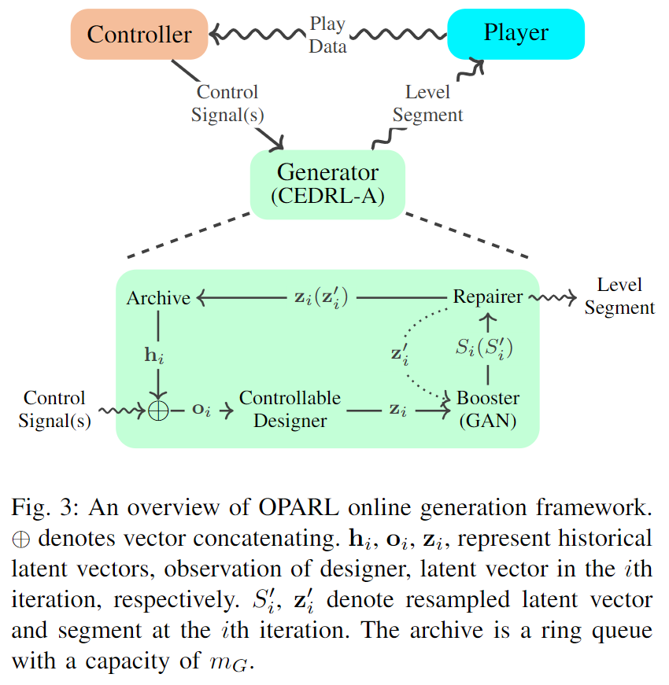
Online Player Adaptive Reinforcement Learning
A controller records play data, and predict time window that the next level segment will be player based on the records.
A generator is built upon the EDRL framework, with the controllable PCGRL technique.
The system is compatible with any features of music and level, and any mapping function
We focus on level generation from music in this work, but the framework can be adapted to other tasks such as online generation with dynamic difficulty adjustment

Slide 8
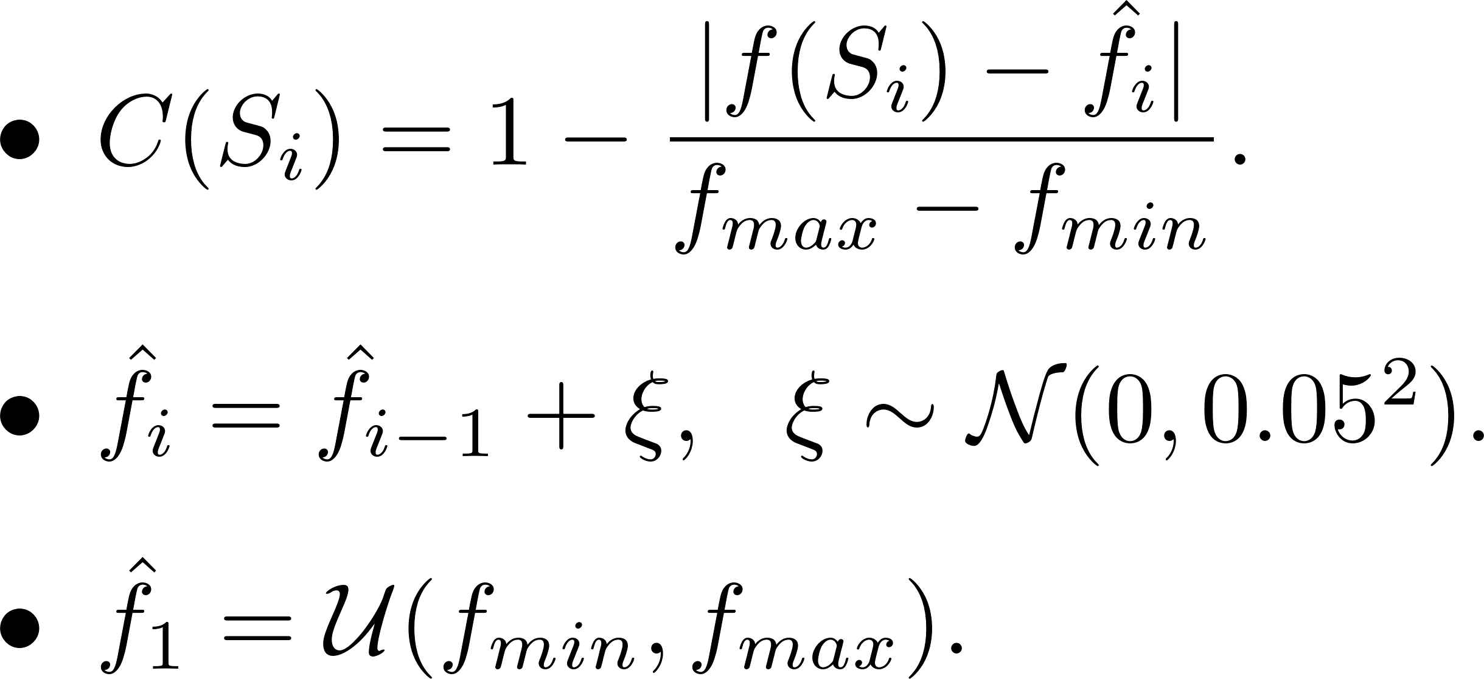
Training Controllable Experience Driven Online Generator
Aim: train a controllable RL designer that receives desired feature target as input, and generate level segment with corresponding feature. (minimise inner error)
Approach: Penalise the RL designer on the error between features of generated level segments and random feature target sequences.
Controllability reward:
Designer is penalised with error between feature targets and actual feature of generated levels
Feature targets is sampled by applying Gaussian mutation on the last one.
The first feature target is sampled uniformly from the range of feature
(No play duration of level segment is considered in the training stage)

Slide 9
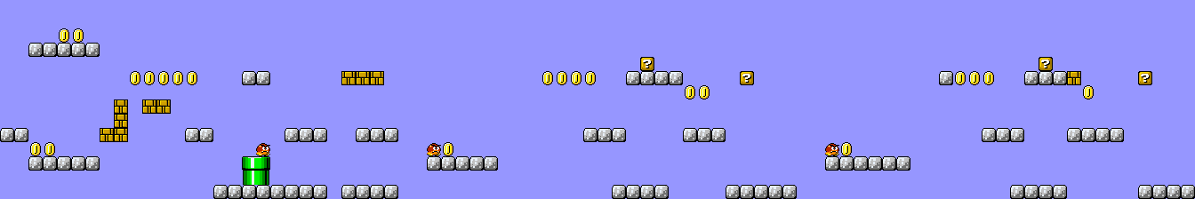

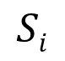
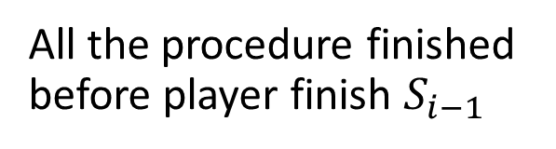
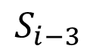

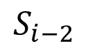
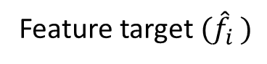
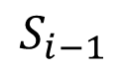
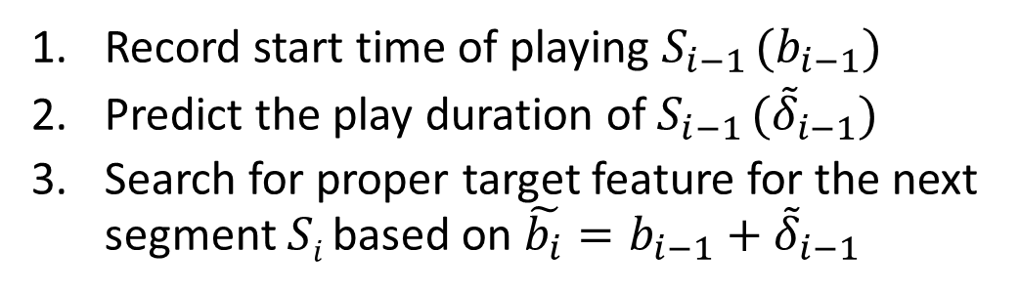
Time Line of Generating New Level Segment
$$S_{i−3}$$
$$S_{i−2}$$
$$S_{i−1}$$
$$Si$$
New segment $(Si)$
Player start to play $Si$
All the procedure finished before player finish $S_{i−1}$
Generator
Controller
Feature target $({\hat{f}}_{i })$
Record start time of playing $S_{i−1} (b_{i−1})$
Predict the play duration of $S_{i−1} ({\tilde{δ}}_{i−1})$
Search for proper target feature for the next segment $Si$ based on $\tilde{b_{i}}=b_{i−1}+{\tilde{δ}}_{i−1}$

Slide 10
Predict the Time Window of Experiencing Next Segment
Different feature targets lead to different level segments, result in different play duration
We need to predict the time window (start time b_{i} = b_{i-1} + δ_{i} and duration of next segment δ_{i}) of experiencing the next segment
(We predict δ_{i-1} and δ_{i} in practical as we can know b_{i-1} exactly)
Predict duration:
Maintain an archive of tuples of feature target and play duration.
Predict the play duration by k-nearest neighbour, averaged duration of k records that have the most close feature target is output as prediction.

Slide 11
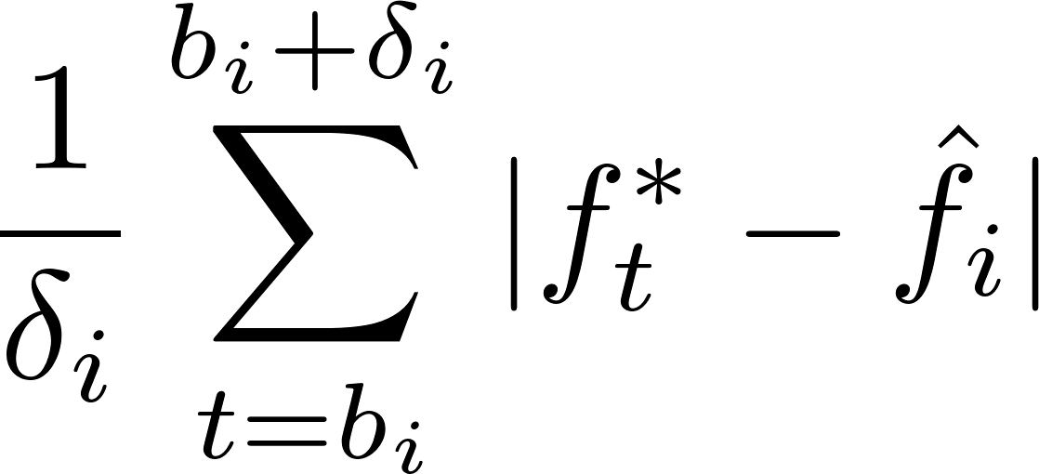
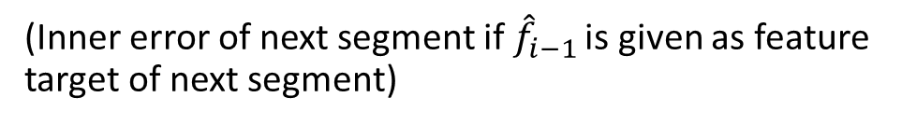
Determine Feature Target in Real-Time
We need to predict the time window that player experience the next segment
Different feature targets lead to different level segments, result in different play duration
We need to search for a proper feature target so that the inner error of next segment can be minimised.
Approach: random local search with Gaussian mutation (start from ${\hat{f}}_{i−1}$)
Fitness function:
(Inner error of next segment if ${\hat{f}}_{i−1}$ is given as feature target of next segment)

Slide 12
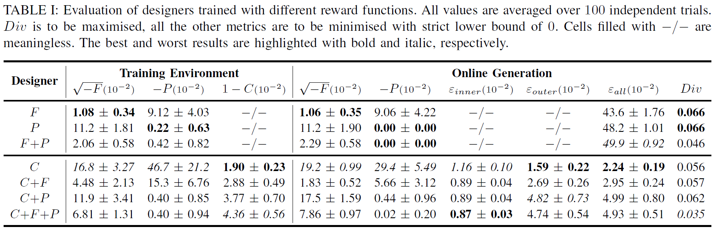
Training Results
We train an MarioGAN¹ as booster, and train RL designer with soft actor-critic
Our implemented OPARL achieves low over-time-error between ideal features and practical features
The generator also achieves high performance on the experience-driven rewards
The design of controllability reward with our training algorithm is effective enough
¹https://github.com/CIGbalance/DagstuhlGAN

Slide 13
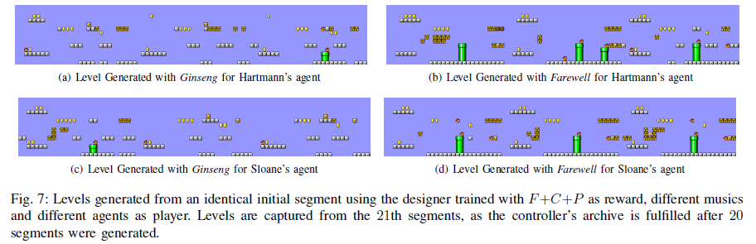
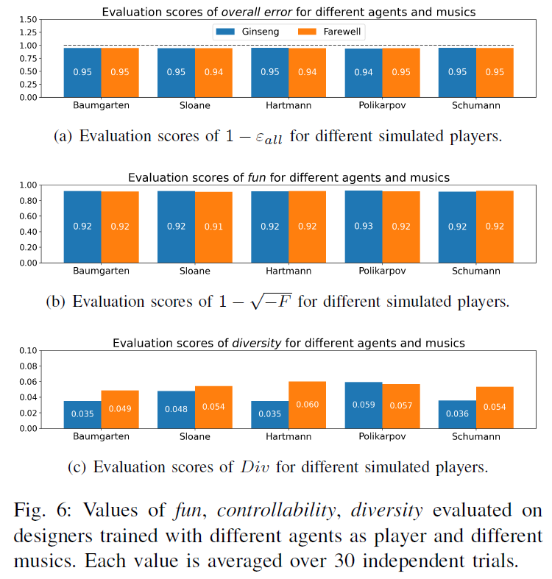
Simulation-based Evaluation
Segments are not really diverse and novelty though “fun” defined in [1] is employed as reward ☹
Robust for different (simulated) players and music ☺

Slide 14
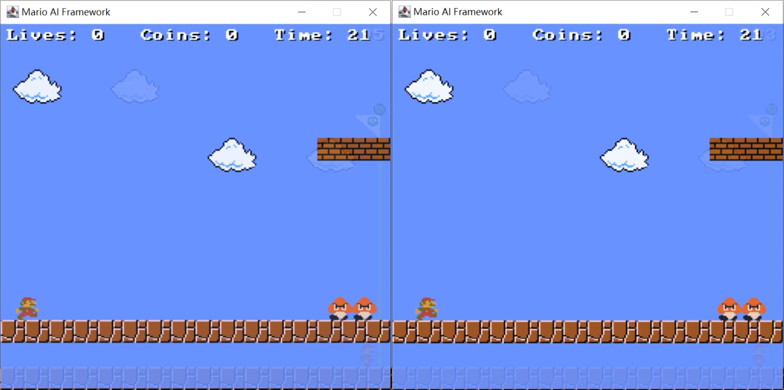
Video Demo (Played by A* agent)
Left: Online generation without music-driven feature control.
Right: Online generation with OPARL that matching level difficulty with the “energy” of music’s

Slide 15
Conclusion
We formulate the problem of online level generation from music, which requires level features be matched with music features over time.
We introduce an OPARL framework which involves a controllable generator and a LS-KNN controller to suggest feature targets in real-time
Simulation-based experiments show the effectiveness robustness of our approach
Limitations:
The way of extracting and mapping level and music feature is a bit naive
Lack of human evaluation
Future works:
Try more and better feature extracting, mapping methods, involve more types of content
Extend the framework to other tasks like dynamic difficulty adjustment

